Slide 1



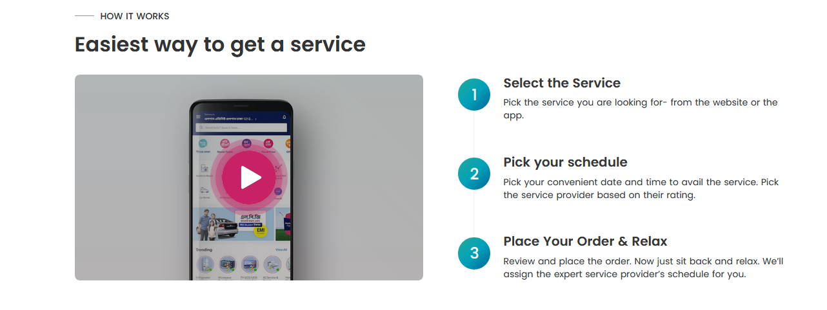
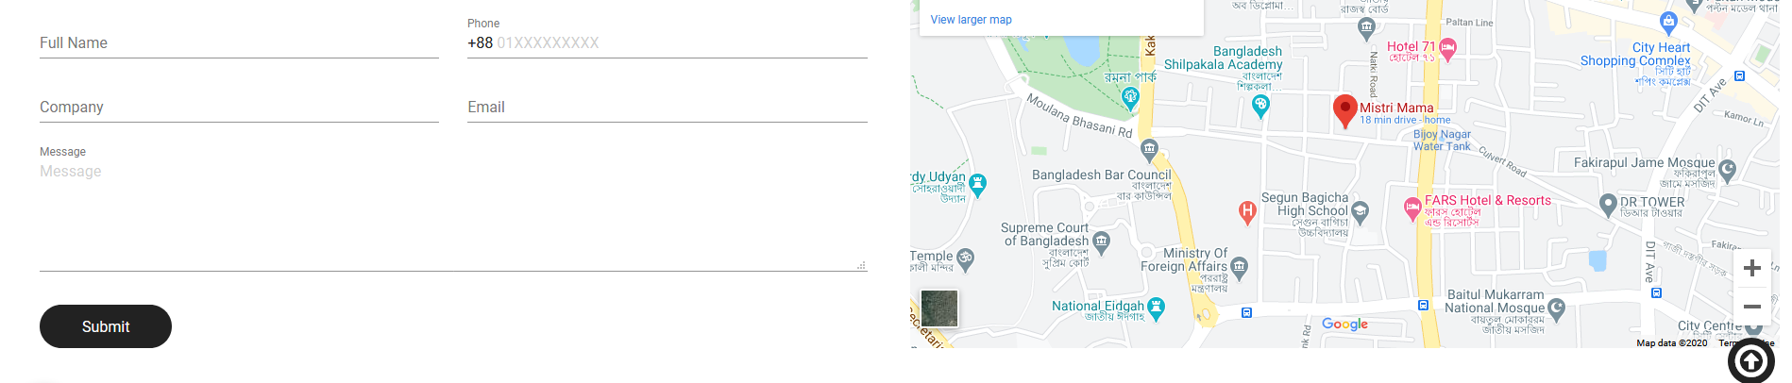
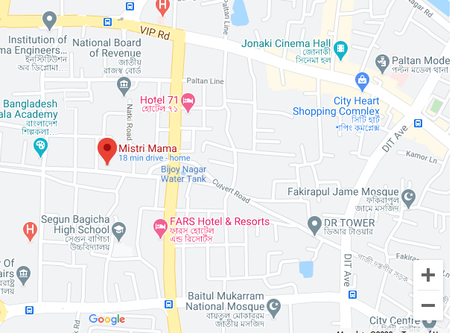

Home All Services About Us Order Contact Us Become Service Provider Login Sign Up
Services
Give Us Feedback
Online Home Repair Office
Head Office: 3rd floor, UCEP Tower, 25 Road, Dhaka 1000
Business Office: Sky View Ocean Tower (1st floor), Dhaka, Bangladesh
+8809610-222-111
onlinehomerepair@gmail.com.com
Saturday-Thursday: 8:00 am - 8:00 pm
Services
Electrical Services
Plumbing Services
Company
About Us
Career
Community Guidelines
Terms & Conditions
Privacy Policy
Contact Us
Discover
News & Articals
How it Works
Earn Money
FAQ
Corporate Pitch
Become Service Provider

Slide 2
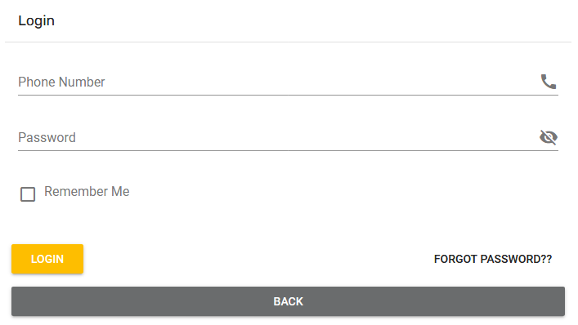
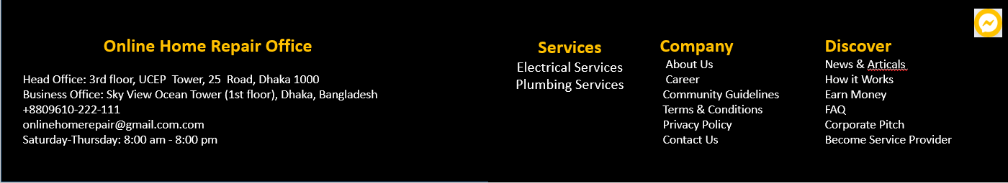

Slide 3
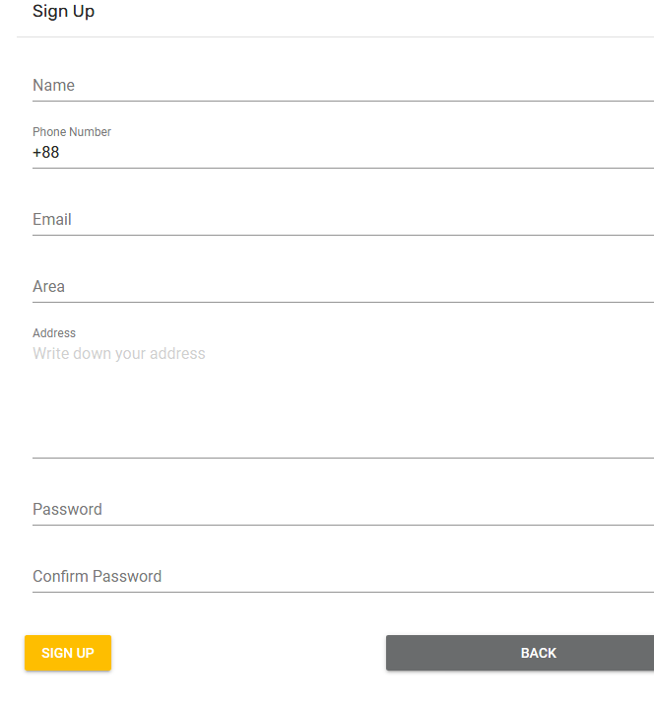

Slide 4
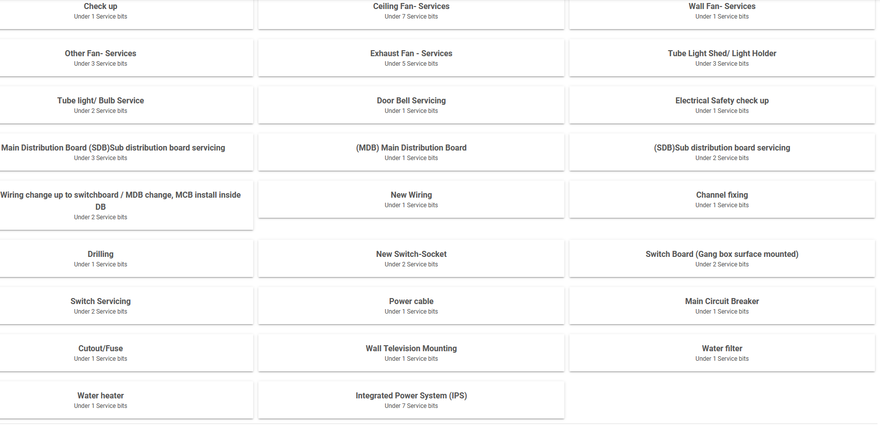

Slide 5
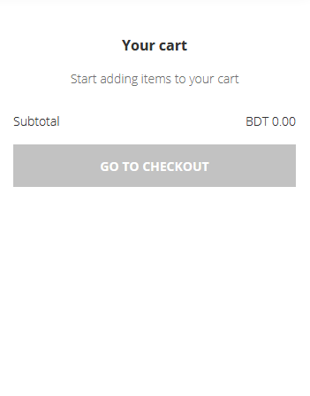
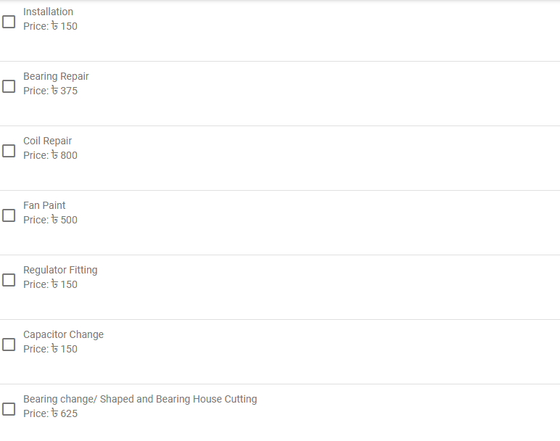





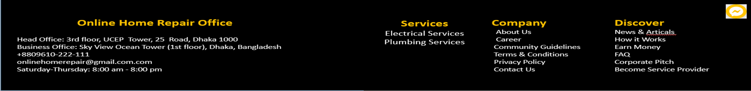

Slide 6
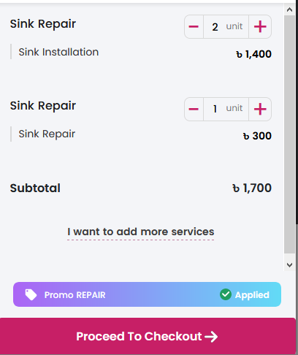

Slide 7
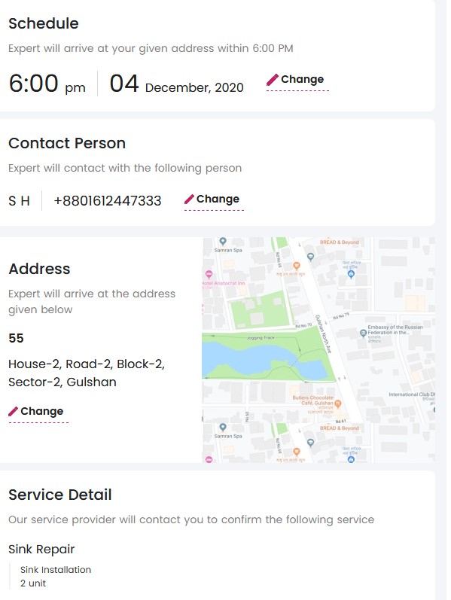
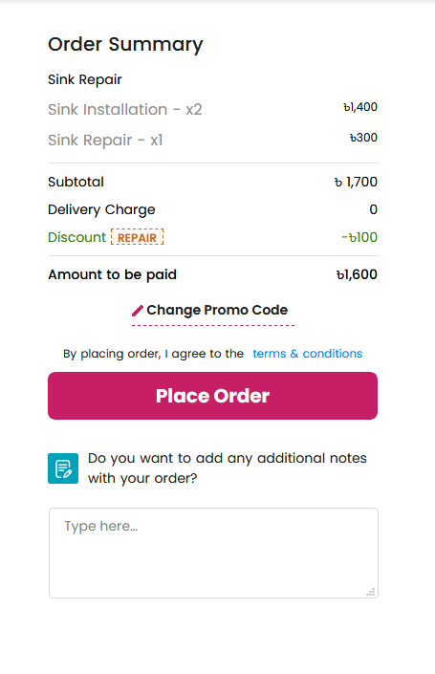
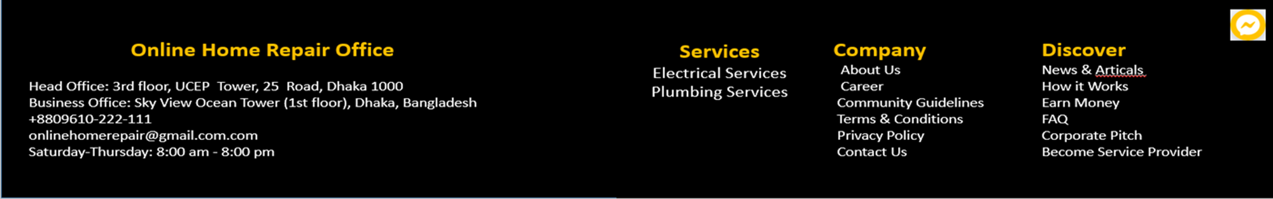

Slide 8
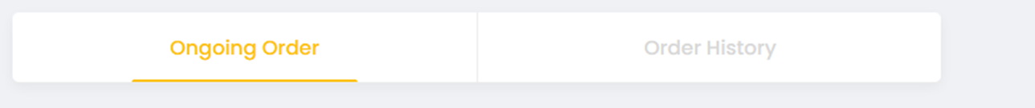
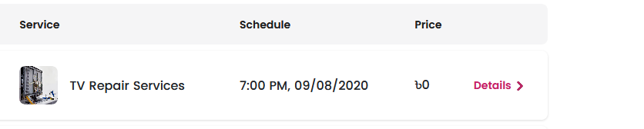
My Account
Profile
My Addresses
Orders
Promotions
Reviews
My Offers
Details | Report Issue

Slide 9
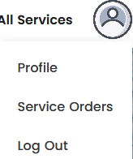
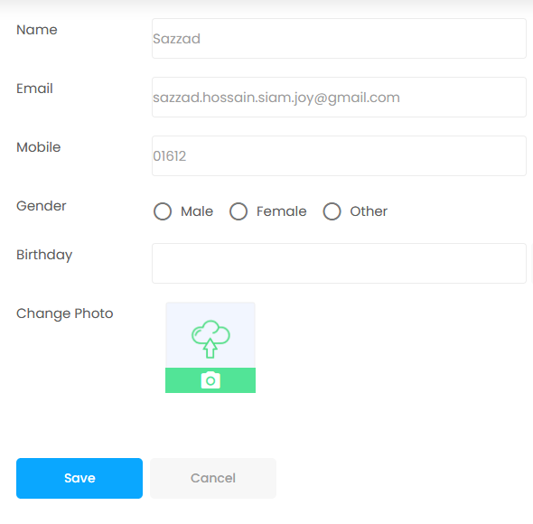
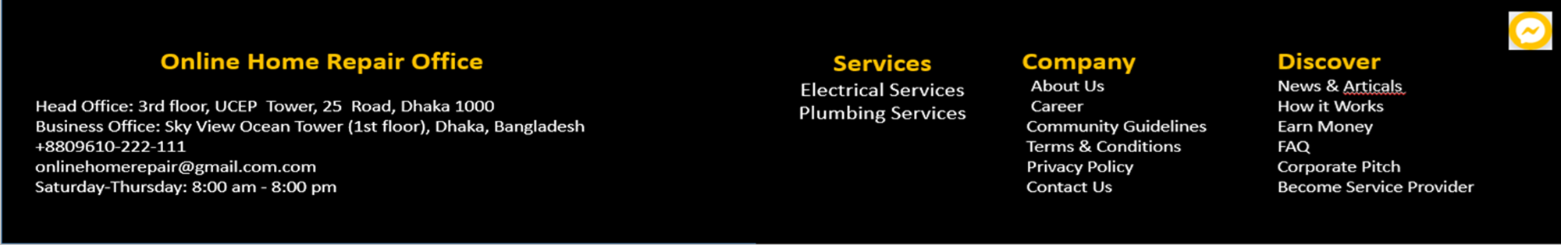
My Account
Profile
My Addresses
Orders
Promotions
Reviews
My Offers

Slide 10
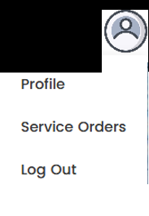
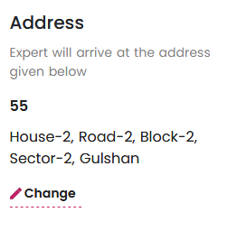
My Account
Profile
My Addresses
Orders
Promotions
Reviews
My Offers

Slide 11

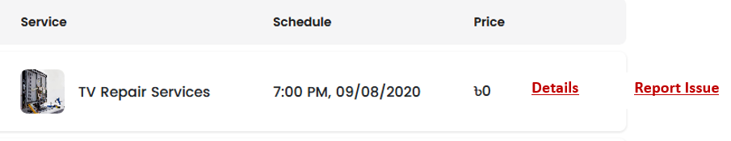
My Account
Profile
My Addresses
Orders
Promotions
Reviews
My Offers

Slide 12

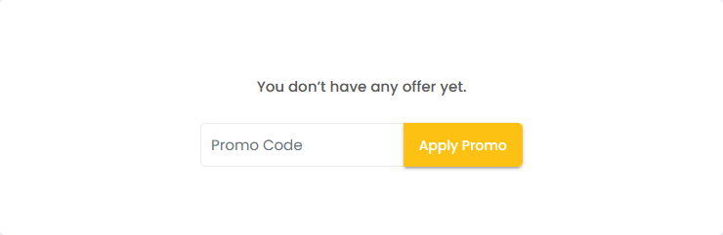
My Account
Profile
My Addresses
Orders
Promotions
Reviews
My Offers

Slide 13
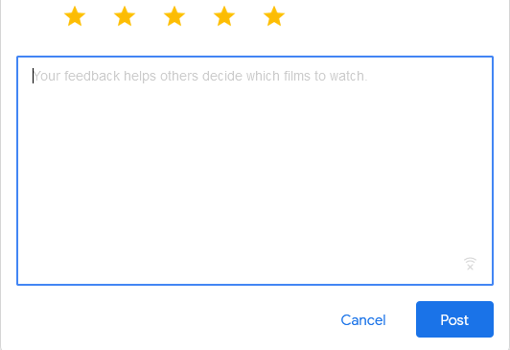
My Account
Profile
My Addresses
Orders
Promotions
Reviews
My Offers

Slide 14
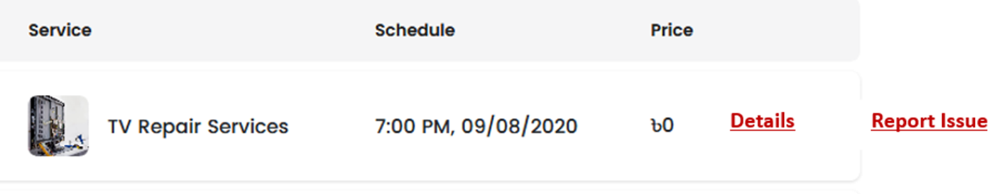
My Account
Profile
My Addresses
Orders
Promotions
Reviews
Invite a friend
My Offers

Slide 15
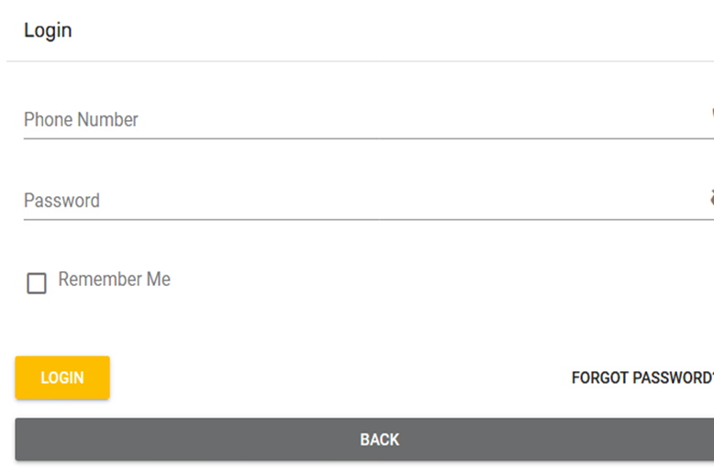
Login As Service Provider
Register

Slide 16

Register As Service Provider

Slide 17
Contact Us
Dashboard
My Job List
My Reviews
My Account
Security
Dashboard
Dashboard
Logout
Reviews
Your Jobs
Notification
MAIN NAVIGATION
Complete Profile

Slide 18
Contact Us
Dashboard
My Job List
My Reviews
My Account
Security
Dashboard
Logout
Job List
SL No. | Customer Name | Phone Number | Area | Service Type | Time | Edit
MAIN NAVIGATION
Complete Profile

Slide 19
Contact Us
Dashboard
My Job List
My Reviews
My Account
Security
Dashboard
Logout
Review
SL No. | Customer Name | E-Mail | Rating | Description | Time | Edit
MAIN NAVIGATION
Complete Profile

Slide 20
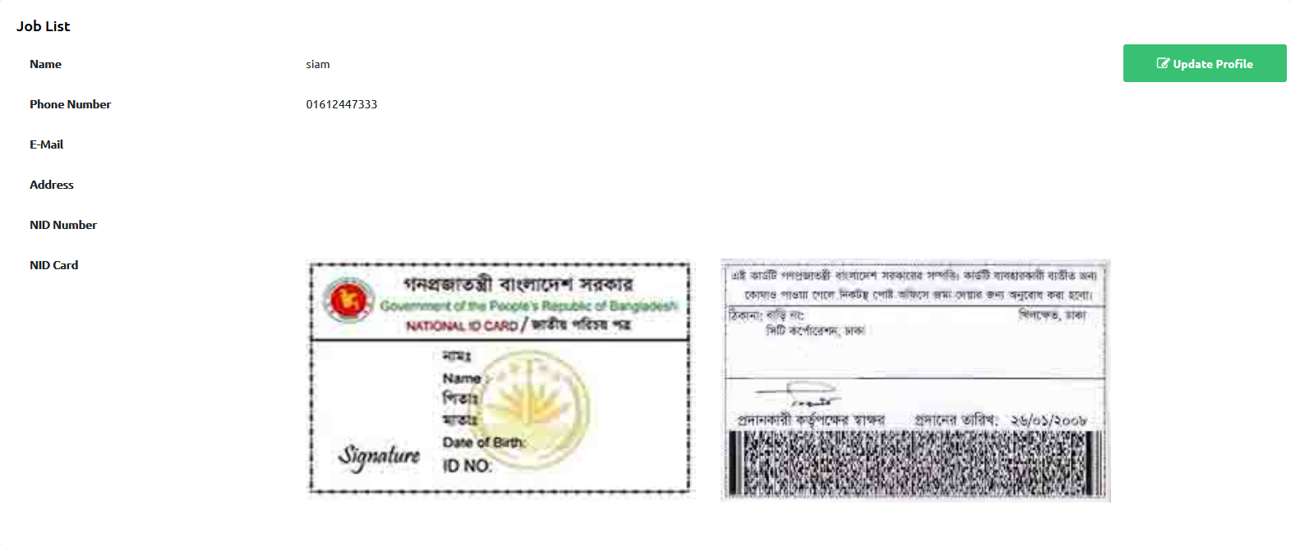
Contact Us
Dashboard
My Job List
My Reviews
My Account
Security
Profile
Dashboard
Logout
Update Profile
MAIN NAVIGATION
Complete Profile

Slide 21
Contact Us
Dashboard
My Job List
My Reviews
My Account
Security
Dashboard
Logout
Security
Your privacy and security are top priority. We do all we can to keep your account secure, and we encourage you to do the same by following best practices: Update your password regularly, enable Two-Factor Authentication, and keep your Support PIN private.
One Time Password:
MAIN NAVIGATION
Complete Profile
Password:

Slide 22

Contact Us
Dashboard
My Job List
My Reviews
My Account
Security
Personal Information | Company Information | Provide Area & Service | Service Opening Time | Your Bank Account Details
Dashboard
Logout
Your Name
Phone Number
Phone Number
National Id Card
Upload NID Image
Upload Your Photo
MAIN NAVIGATION
Complete Profile

Slide 23
Contact Us
Dashboard
My Job List
My Reviews
My Account
Security
Personal Information | Company Information | Provide Area & Service | Service Opening Time | Your Bank Account Details
Dashboard
Logout
Company Name
Service Delivery Type
License number
Company Address
Company Logo
MAIN NAVIGATION
Complete Profile

Slide 24
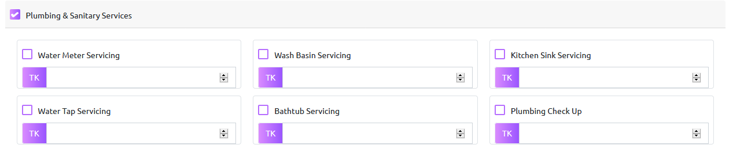
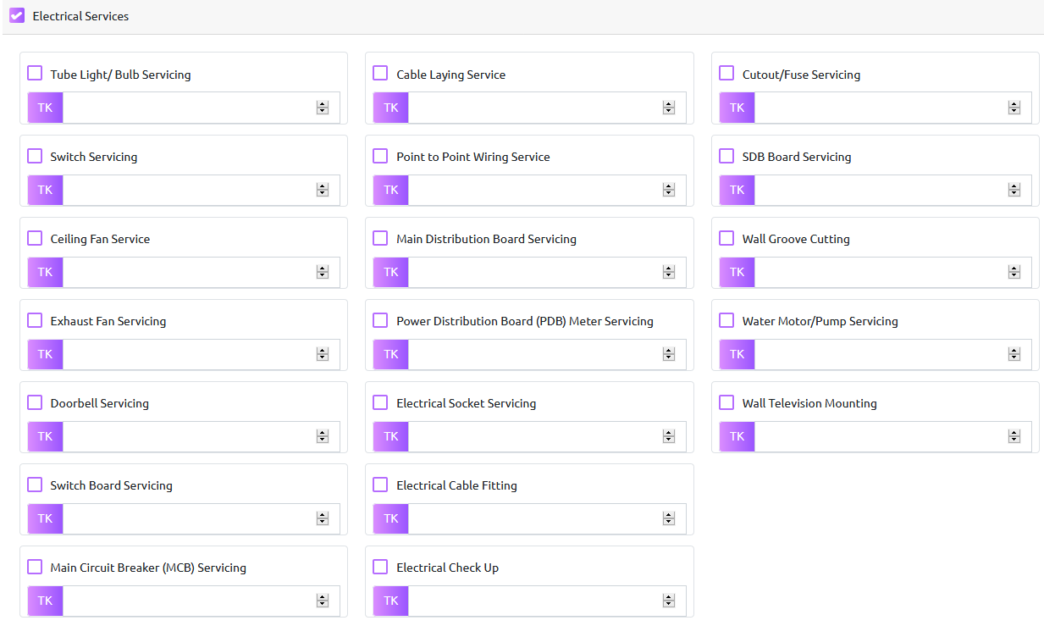
Personal Information | Company Information | Provide Area & Service | Service Opening Time | Your Bank Account Details
Dashboard
Logout
Dashboard
My Job List
My Reviews
My Account
Security
Select Service Area
Service Warranty in days
Select Provider Service & Sub Service (select multiple service & sub service & input price)
MAIN NAVIGATION
Complete Profile

Slide 25
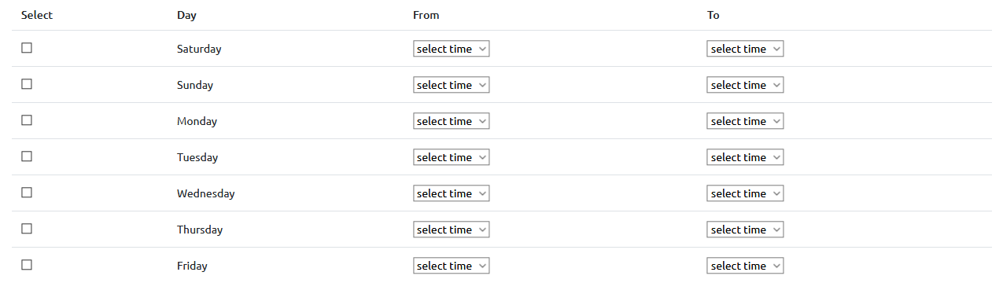
Contact Us
Dashboard
My Job List
My Reviews
My Account
Security
Dashboard
Logout
Personal Information | Company Information | Provide Area & Service | Service Opening Time | Your Bank Account Details
MAIN NAVIGATION
Complete Profile

Slide 26
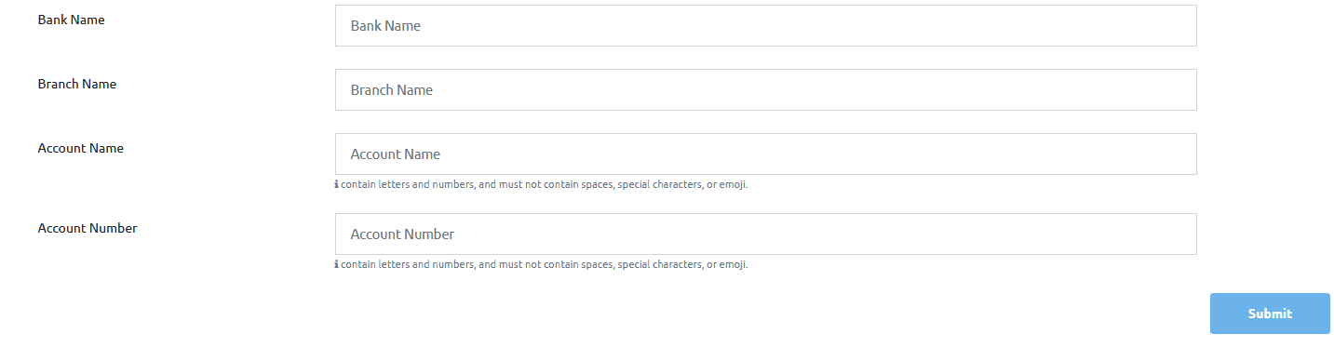
Contact Us
Dashboard
My Job List
My Reviews
My Account
Security
Personal Information | Company Information | Provide Area & Service | Service Opening Time | Your Bank Account Details
Dashboard
Logout
MAIN NAVIGATION
Complete Profile

Slide 27
Contact Us
ADMIN
Dashboard
Logout
Dashboard
Serviceman List
Serviceman Reviews List
Customer List
Security
Feedbacks
Options: Message, Terminate membership, see legal info
See rating of serviceman for better understanding
Options: Message, Terminate membership, see legal info
Same as Serviceman
Feedback from customers and serviceman
MAIN NAVIGATION
Complete Profile

